Slide 1
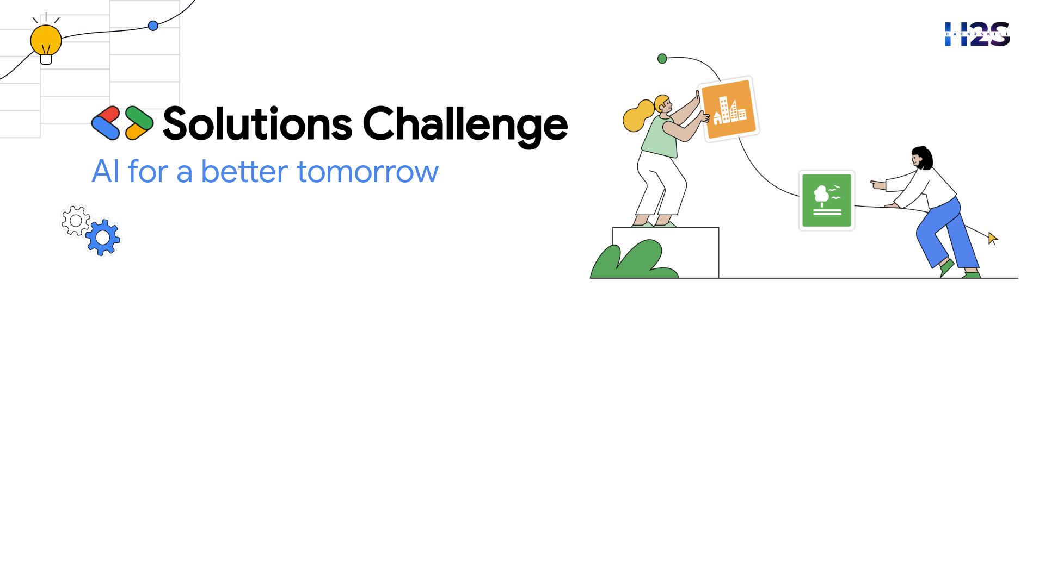
Idea Submission for Bootcamps
Team Details:
Team name: PLASMA CODEX
Team leader name: Soham Khan
Problem Statement: Marginal Farmers with AI-Driven Agricultural Solutions

Slide 2

AI-Powered Soil Health Monitoring System
Objective : To help small and marginal farmers in India to improve crop productivity by providing real- time soil health monitoring and actionable recommendations.
How It Works :
Arduino Sensors: Low-cost sensors measure soil moisture, pH, and nutrient levels.
AI Analysis: Pre-trained models analyze soil data to detect issues like nutrient deficiencies.
Mobile App: Farmers receive real-time alerts and recommendations in Bengali via a simple app.
Key Benefits:
Early Detection: Identify soil issues before they harm crops.
Cost-Effective: Reduce unnecessary use of fertilizers and pesticides.
User-Friendly: Accessible to farmers with limited tech experience.
Impact : Improves crop yield, promotes sustainable farming, and empowers farmers with data-driven decisions.

Slide 3
Opportunities & Unique Value
Real-Time Monitoring: AI-powered drones provide instant crop health updates. Predictive Analytics: Detects issues early & suggests preventive actions. User-Friendly App: Supports local languages for easy farmer access.
Problem Solving Approach
Early Detection: Identifies crop diseases & stress before they spread. Actionable Insights: Delivers precise, farm-specific recommendations. Resource Optimization: Reduces fertilizer/pesticide waste & costs.
Unique Selling Proposition (USP)
All-in-One Platform: Data collection, AI analysis, and real-time alerts. Localized Support: Adapts to regional conditions for better accuracy. Scalable Solution: Works across various crops & locations.
This AI-driven solution empowers farmers with technology to boost productivity & sustainability.

Slide 4
Arduino Sensors:
Measure soil moisture, pH, and nutrient levels.
Low-cost and easy to deploy in fields.
AI-Powered Analysis:
Use Google Teachable Machine or TensorFlow Lite to analyze soil data.
Detect nutrient deficiencies, imbalances, and contamination.
Real-Time Alerts:
Mobile app (built with Flutter & MIT App Inventor) sends alerts to farmers.
Provides actionable insights like fertilization and irrigation schedules.
Data Storage and Management:
Use Google Firebase to store and manage soil data securely.
Predictive Insights:
Use Google BigQuery to analyze historical soil data and provide predictive recommendations.
Local Language Support:
App supports Bengali (using Google Translate API) for easy understanding by local farmers.
Scalable Design:
Built on Google Cloud Platform (GCP) for scalability to monitor additional soil parameters or regions.
List of features offered by the solution

Slide 5
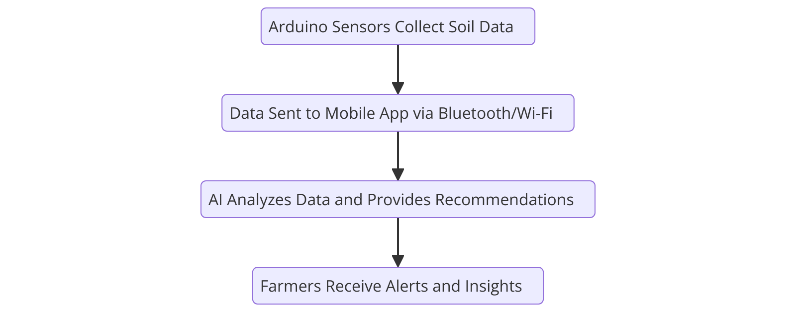
Process flow diagram
The flowchart illustrates how Arduino sensors collect soil data, transmit it to a mobile app, AI analyzes it, and farmers receive actionable insights.

Slide 6
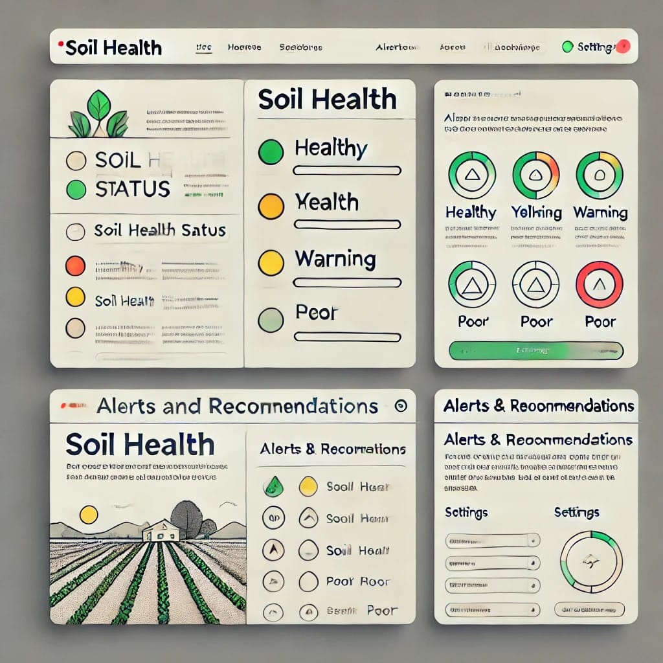
Wireframes/Mock diagrams of the proposed solution

Slide 7
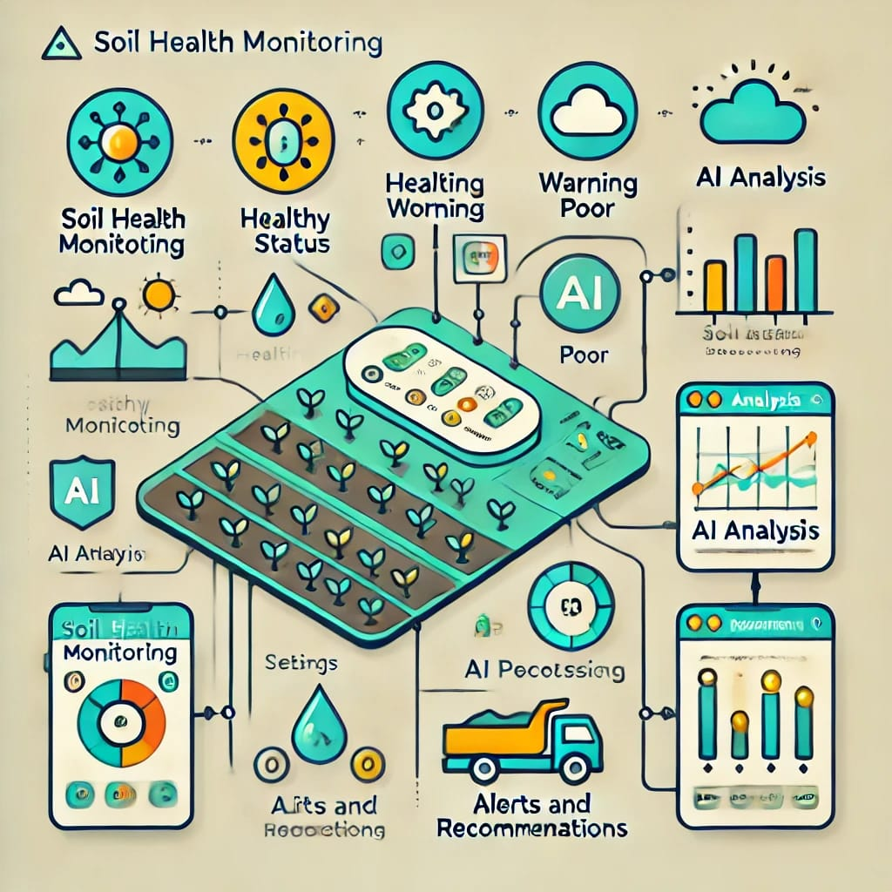
Architecture diagram of the proposed solution

Slide 8
Technologies that are being used/planning use during prototype development
Arduino Sensors:
Measure soil moisture, pH, and nutrient levels.
AI and Machine Learning:
Google Teachable Machine: Train and deploy soil health analysis models.
TensorFlow Lite: Run lightweight AI models on mobile devices for real-time insights.
Mobile App Development:
Flutter: Build a cross-platform mobile app for real-time alerts and recommendations.
Data Storage and Management:
Google Firebase: Store and manage soil data securely.
Firestore: Real-time database for seamless data synchronization.
Predictive Analytics:
Google BigQuery: Analyze historical soil data and weather patterns for predictive insights.
Cloud Infrastructure:
Google Cloud Platform (GCP): Scalable and secure hosting for the entire solution.
Local Language Support:
Google Translate API: Integrate Bengali language support for local farmers.

Slide 9
Estimated implementation cost
Category | Item | Cost (₹) | Purpose
Hardware Costs | Low-Cost Microcontroller (e.g., Arduino Nano) | 500–800 | Connects soil sensors and collects data
 | Basic Soil Moisture Sensor | 150–300 | Measures soil moisture levels
 | Affordable pH Testing Kit | 300–600 | Measures soil pH levels
 | DIY Bluetooth Module (HC-05) | 150–300 | Enables wireless communication
Total Hardware Cost |  | 1,100–2,000 | Budget-friendly alternative
Miscellaneous Costs | Prototyping Materials | 300–700 | Wires, connectors, basic setup
 | Transportation & Field Testing | 500–1,000 | Travel costs for local testing
Total Miscellaneous Cost |  | 800–1,700
Total Estimated Cost | Basic Prototype | ₹1,900–₹3,700 | Affordable solution for farmers

Slide 10
Future Development
Add support for more soil parameters (e.g., temperature, organic matter).
Integrate weather data using Google Cloud Weather API for better predictive insights.
Expand to other regions and crops for wider impact.
Advanced AI Models:
Use Google Vertex AI to develop more sophisticated soil health prediction models.
Farmer Training Programs:
Collaborate with local agricultural organizations to train farmers on using the system.

Slide 11
Provide links to your:
GitHub Public Repository

Slide 12

TEAM- PLASMA CODEX

